Slide 1
Welcome to the LogistiCare Web Seminar
MAINECARE
FACILITY SERVICE PRESENTATION

Slide 2
Who is LogistiCare ?
LogistiCare is a transportation management solution; not a transportation company.
Maine is unique, this is the only state in which LogistiCare maintains a small fleet of “recovery” vehicles. We are focused on the growth of the local networks of professional transportation companies. These networks consist of local, commercial, non-profit and public transportation companies. We are continuously partnering with high quality providers to deliver a transportation service that is safe, reliable and timely.

Slide 3
Credentialing of our network.
Prior to becoming a provider in our network, a company must undergo the LogistiCare 3-step credentialing process
Company financial and reference review
Review of safety compliance procedures, driver and attendant background checks
Site visits that include vehicle and driver inspections
During the site visit, LogistiCare inspects provider records and vehicles. The transportation provider must produce:
An operations manual
A certificate of insurance
Records of criminal background checks for drivers and attendants
Vehicle information and recent maintenance schedules
Drivers' licenses and required business licensing
We insist that our network takes the credentialing requirements seriously by focusing on: Adherence · Documentation · Commitment

Slide 4
Transportation Protocols and Hours of Operation
Standard Days and Hours of Customer Service Center Operation for Routine Reservations
Open Monday - Friday
8:00 am to 5:00 pm EST
Closed Saturdays and Sundays
Closed on national holidays
Transportation Services
Available 24/7/365
Standard Days and Hours of Customer Service Center Operation for Trip Recovery, Discharges, and Urgent Requests
Available 24/7/365

Slide 5
Screening Criteria
Who can request transportation?
Members over the age of 16 years
Member’s relative or legal guardian, or authorized representative
Medical provider
Hours of Notice for Routine (non-urgent) Medical Appointment
48 business hours (2 business days)
How far in advance can members make reservations?
No more than 30 days
Instructions if Member calls less than required hours of notice
If this is the Member’s first time calling, educate Member, schedule trip and note in LogistiCAD
All future attempts, educate Member, note in LogistiCAD, and ask Member to reschedule their appointment to be within the hours of notice requirements. Exception will be made for reservations deemed urgent.
“Will Call” for return trips (when members are not sure how long appointment will last)
Member should call the ride assist line to schedule return trips.
Provider has up to 1 hour for urban locations and 2 hours for rural locations from the time of the call to pick up member.

Slide 6
Screening Criteria (cont.)
Modes of Transportation Covered
Ambulatory: Sedan, van, taxi
Wheelchair lift-equipped vehicle
Mass Transit – Public Transit
Mileage Reimbursement- Family and friends
Meals and lodging
Covered with Pre-Authorization from MaineCare
Transportation to/from Hospital Emergency rooms
Not allowed to ER
Allowed from ER
Not allowed between ERs

Slide 7
Screening Criteria (cont.)
Trips to the pharmacy
Allowed
Limits to trip length, as measured in miles
Allowed following mileage guidelines set by MaineCare
Requests for transportation out of state
Requires prior authorization MaineCare
Wheelchair/DME/Car Seats
LogistiCare does not provide wheelchairs for transportation. If a member requires a car seat, please let the customer service representative know at the time of the reservation.
Minor’s traveling without an adult escort
A minor under the age of 16 years requires a consent form on file with LogistiCare if they need to travel alone. The consent form needs to be complete and signed by the minor’s parent or guardian.

Slide 8
Reservation- Toll Free Numbers (Facilities)
Facility Service Department: 877-659-1305 (Medical facilities including but not limited to: Dialysis, hospitals, cancer centers)
Facility Fax Number: 877- 637-9091 – Facilities are able to fax in Standing orders and single trip requests using this toll free number

Slide 9
Reservation -Toll Free Numbers (Members)
The numbers listed below are specific toll free numbers for the beneficiaries, their families/care givers or medical providers call to reserve a demand response/episodic trip for the beneficiary.
E.g.: a trip to the doctor on Thursday.
855-608-5174 Region 1 (Includes Aroostook County)
855-608-5176 Region 2 (Includes Washington County and Hancock County)
855-608-5178 Region 6 (Includes Cumberland County)
855-608-5180 Region 7 (Includes Oxford County (not including towns in region 8), Androscoggin County and Franklin County
877-659-1302 Region 8 (Includes York County, and Brownfield, Denmark, Fryeburg, Hiram, Porter, Lovell, Stoneham, Stow, Sweden cities in Oxford County)

Slide 10
Ride Assist- Toll Free Numbers
Where case managers, social workers and beneficiaries (or their families/care givers) call concerning a service issue
E.g.: transportation is late dropping off or picking up the patient.
855-608-5175 Region 1 Ride Assist
855-608-5177 Region 2 Ride Assist
855-608-5179 Region 6 Ride Assist
855-608-5181 Region 7 Ride Assist
877- 659-1303 Region 8 Ride Assist

Slide 11
Standing Orders
What is a standing Order?
To eliminate the need to arrange trips for members who have One or more trips to the same facility each week, a standing order form and process has been created. This allows a facility to arrange trips in advance for a member scheduled for treatment three days or more a week to the same location. Example: dialysis, wound care, mental health, and medication management.
A Standing Order will be created and inserted in our system. Our system will propagate the information based on the schedule furnished by the treating facility. Every standing order must be recertified by LogistiCare on a quarterly basis. The treating facility will be asked to verify that the member’s information has not changed since the original standing order was created.
Who fills out the Standing Order Request Form?
Standing order forms must be completed by a representative of the treating facility.
How can I get a Standing Order Request Form?
Standing Order Forms can be obtained through the website or by contacting the Facility Department or it can be completed by accessing the LogistiCare Facility Service Website

Slide 12
Frequently asked questions
What if a facility has a same day or next day urgent trip?
Urgent/same day trips can be booked through LogistiCare. Such trips should be true urgent conditions where a physician is requiring the member be seen the same day or the next day.
What happens if a trip is booked and the transportation provider is late picking up the member?
In the event that a transportation provider is late, LogistiCare maintains a staff trained to resolve late arrivals. A dedicated phone line is available to inquire about the status of their ride. The line is called the “Ride Assist” line and the phone number to call is: 877-659-1303
What happens if we don’t know what time the member’s appointment will be over and no time is arranged in advance for the return ride?
Once their appointment is finished, the member or facility will call the "Ride Assist" phone number and request transportation be sent to return the member. The transportation provider will be dispatched and will have up to one (1) hour for urban locations and 2 hours for rural location to arrive for the member’s return ride.
The member/facility will use the same "Ride Assist" phone number: 877-659-1303
What if a Facility has an emergency trip?
Emergency ambulance trips are not arranged through LogistiCare. If a medical emergency ambulance trip is needed, 911 should be called.

Slide 13
FAQ (cont.)
How do hospitals arrange discharges?
Physician's Transportation Restriction Forms are not needed for hospital discharges. Dedicated Facility Coordinators are assigned to handle discharges. Once the discharge is arranged, the transportation provider has up to four (3) hours to respond and pick-up the patient. Contact the Facility Department:
Facility Phone: 877-659-1305
Facility Fax: 877- 637-9091
What if a facility has multiple trips to book for different members?
The facility can fill out individual Single Trip Request Form for each member. We do ask that the request not exceed 30 days in advance notice. You can fax the completed form to: 877- 637-9091 . Again, two business days notice is required for routine trips.
Can a facility ask for a preferred transportation provider?
Yes, if a facility has a transportation provider they prefer, please mention this when scheduling transportation. LogistiCare will note the request on the trip and will do everything they can to honor the facility’s request, depending on availability of the transportation provider and/or if the preferred provider is a participant in the LogistiCare network. Even though the request will be documented, trip assignment will be based on routing criteria that includes provider compliance. LogistiCare does not guarantee that a preferred provider will be assigned based on a request.
Can a skilled nursing facility or a MCRD facility utilize LogistiCare for transportation services?
Skilled nursing facilities and MCRD facilities are required to provide transportation to their residence. If the skilled nursing facility is not able to provide transportation, LogistiCare will accommodate the transport. The request will need to include the reason the skilled nursing facility is not able to accommodate the transportation.

Slide 14
Urgent Transportation Requests
Applies only after the member has been educated on the notification policy
Urgent calls are defined as reservation requests for unscheduled episodic situations in which there is no threat to life or limb, but the recipient must be seen with less than 48-hours (2-business days) notice.
If the members appointment type is related to the following list, it is considered “Urgent” in nature and does not require verification:
Dialysis
Wound Care,
Chemo & Radiation
Hospital discharge follow up
Surgical follow up
New on-set of non-life threating injury/ illness.
In the event that a member requires an urgent transport, it is imperative that LogistiCare have the available resources to accommodate the transportation request. If a member is able to safely reschedule a non-urgent appointment, we do ask that they work with the medical provider to schedule their appointment to accommodate the 48-hour notice.

Slide 15
Notification Policy
To ensure proper trip assignment, we require 48 hours notice(2-business days)
In the event that a transportation provider is not able to accommodate an assigned trip, the provider is required to notify LogistiCare 48 hours prior to the scheduled date of service. This notification process allows LogistiCare additional time to secure a transportation provider.
If it is the member’s first time calling - LogistiCare will educate the member on the required notification process and schedule their transportation.
Future attempts - If the member attempts to schedule a non-urgent reservation outside of the 48-hour ( 2 business days) required notice, the CSR will ask the member to reschedule their appointment to meet the 48 hour notice.

Slide 16
Coverage Area
LogistiCare is responsible for members
who reside and are registered in Regions 1, 2, 6, 7, and 8

Slide 17
Coverage Area (cont.)
Region 1 = Includes Aroostook County
Region 2 = Includes Washington County and Hancock County
Region 6 = Includes Cumberland County
Region 7 = Includes Oxford County (not including towns in region 8), Androscoggin County and Franklin County
Region 8 = Includes York County and the Townships of Brownfield, Denmark, Fryeburg, Hiram, Porter, Lovell, Stoneham, Stow, and Sweden in Oxford County

Slide 18
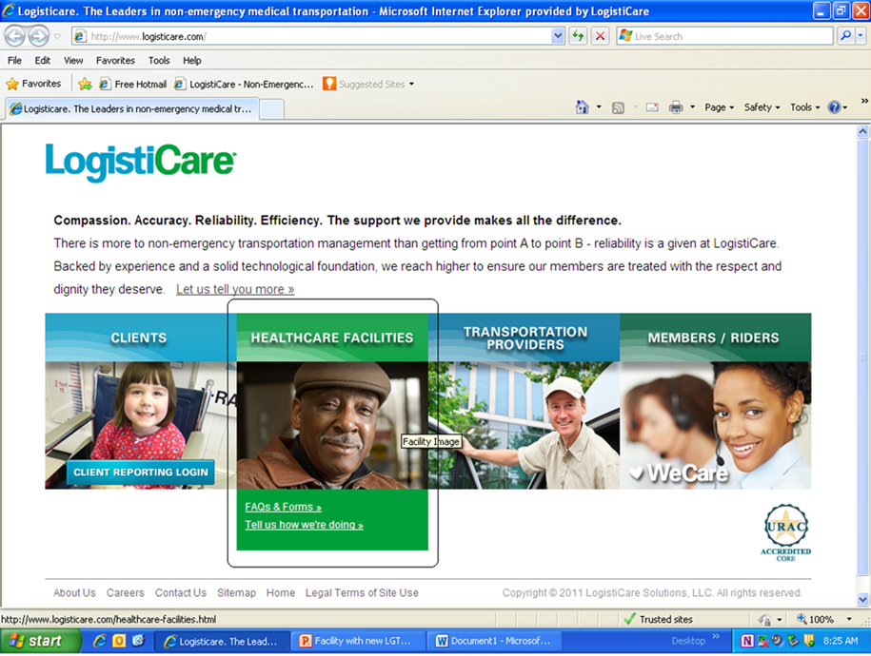
Facility Website Information Facts and forms
Enter the LogistiCare Website: www.logisticare.com
Choose the option Healthcare Facilities
Select FAQs & Forms

Slide 19
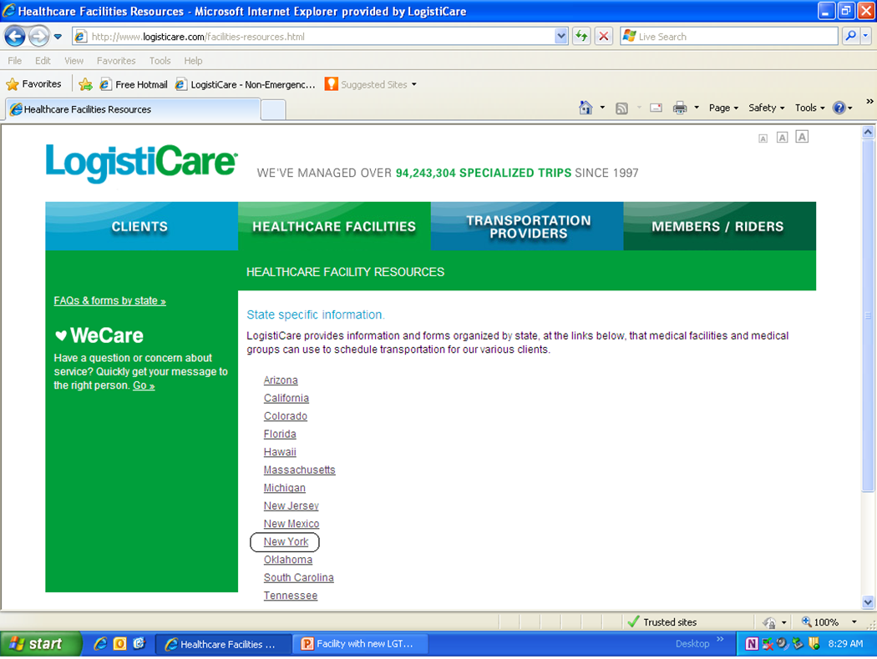
Facility Website Information Facts and forms (cont.)
Select State – Maine

Slide 20
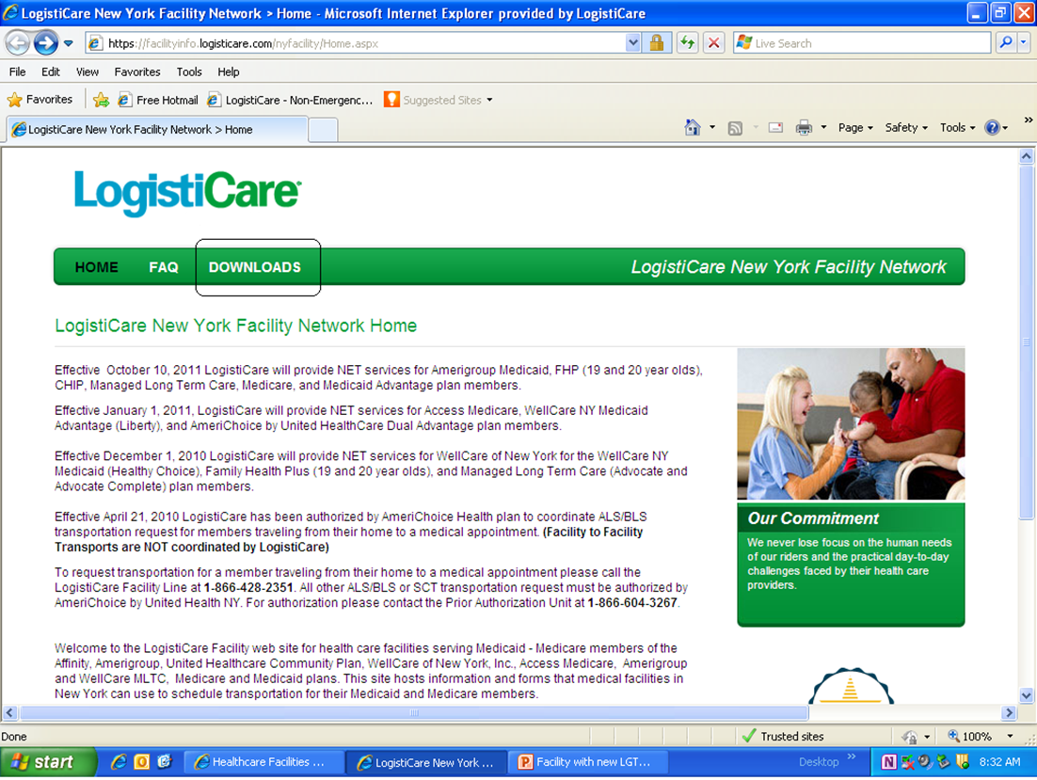
Facility Website Information Facts and forms (cont.)
Select Downloads
Select FAQ

Slide 21
Facility Service Website (Schedule trips on –line)
The LogistiCare Facility Service website supports transportation request from healthcare facilities on behalf of their members.
The Facility Services Web lets you:
Enter a single trip or standing order request for review and approval by a LogistiCare Facility Representative
Look up and view trip requests
Modify or update pending requests
Withdraw pending requests
Manage Facility Services Web user accounts
The secure login function, data encryption, and other security features are designed to protect your clients and your organization. The LogistiCare Facility Services Web site meets all requirements of the Health Insurance Portability and Accountability Act of 1996 (HIPAA) regarding Protected Health Information (PHI) to ensure the privacy and security of your data.

Slide 22
Facility Service Website (cont.)
Accessing the Facility Services Web site
To access the Facility Services Web site, establish your Internet connection and open your browser. In the Address line of your browser, enter the Internet address http://facility.logisticare.com/ and then press ENTER or select the ‘GO’ action.
TIP! You can save the Facility Services Login page as a Favorite web location. On the Favorites menu in your browser, select the Add to Favorites option.
The Login page also provides notices of scheduled maintenance or system updates.
Logging in to the Facility Services Web site
To log in to Facility Services, you will need the User Name and Password that you received from LogistiCare when you signed up for the site or from your system administrator or manager.

Slide 23
Questions
Please take this time to asks questions about our process

